Slide 1
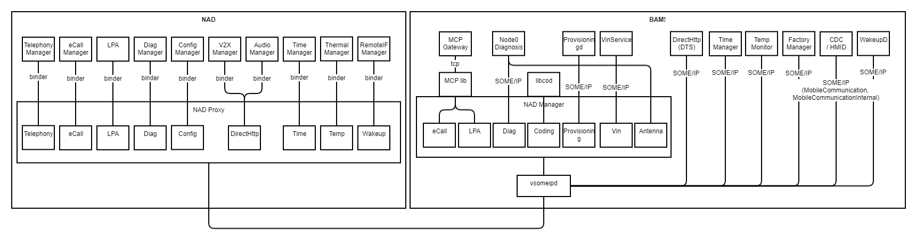

Slide 2
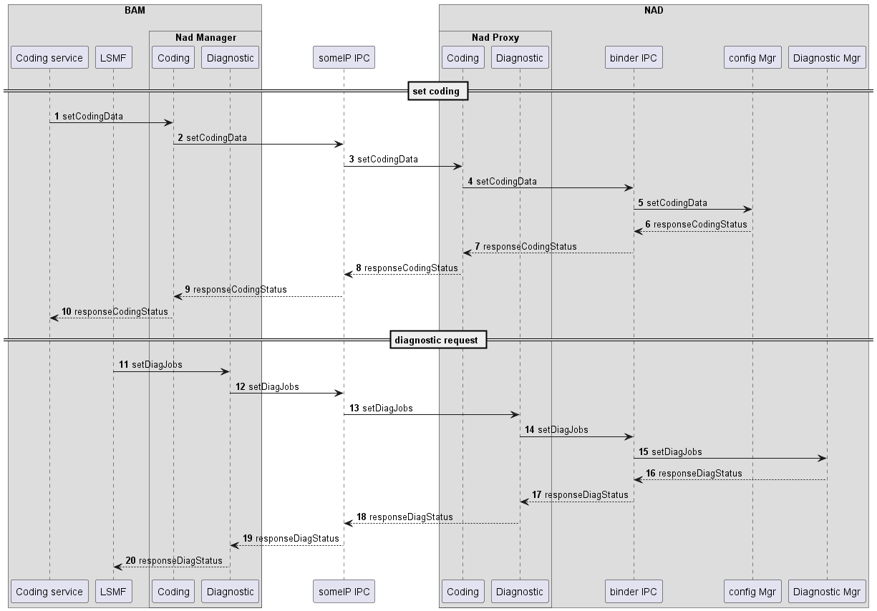

Slide 3
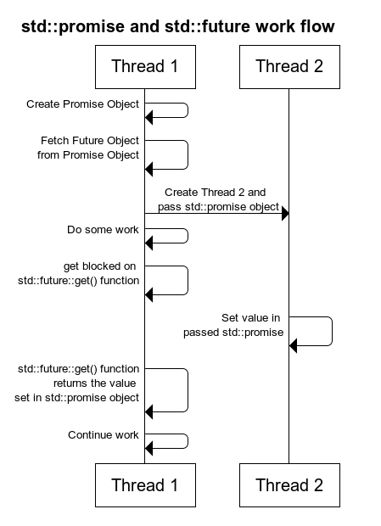
C++ standard lib: future/promise

Slide 4
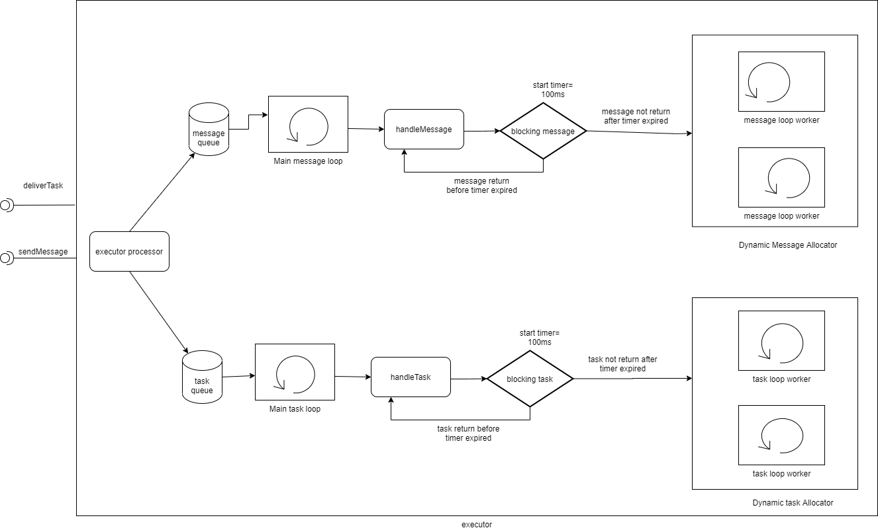
New executor

Slide 5
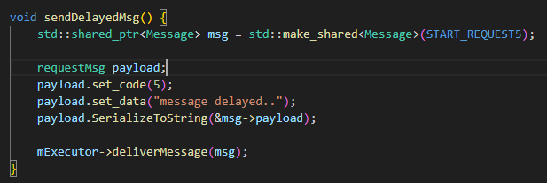
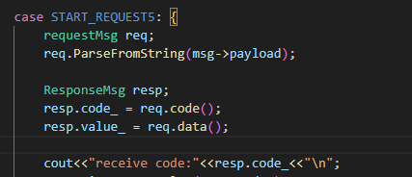
New executor
Send message

Slide 6
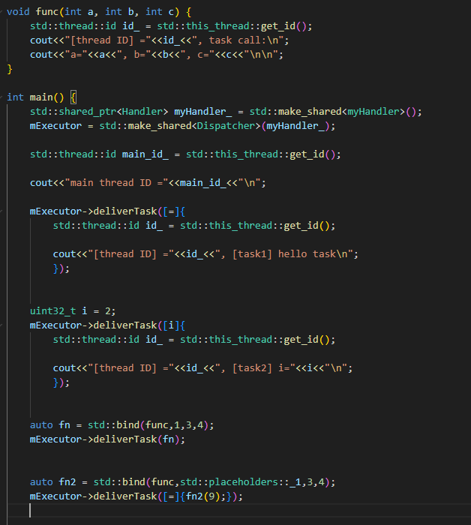
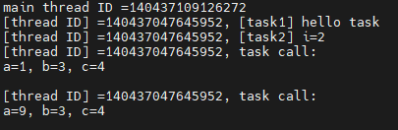
New executor
Send task

Slide 7
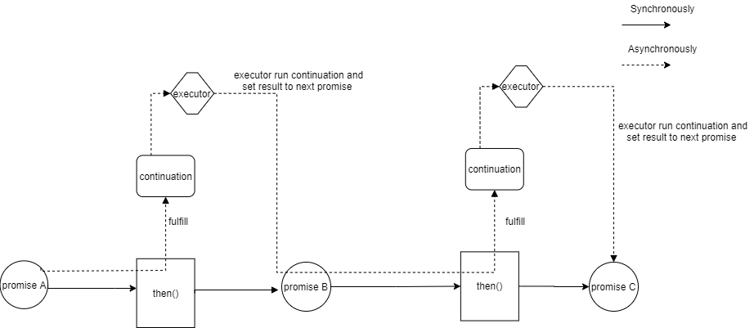
New promise

Slide 8
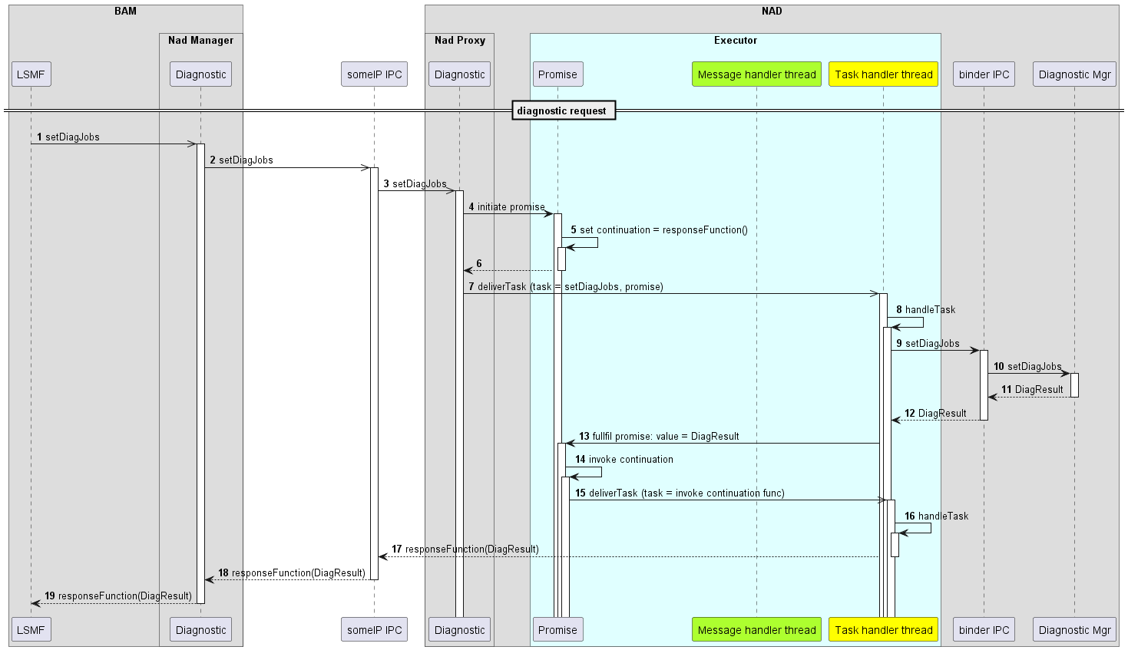
Apply new promise and executor

Slide 9
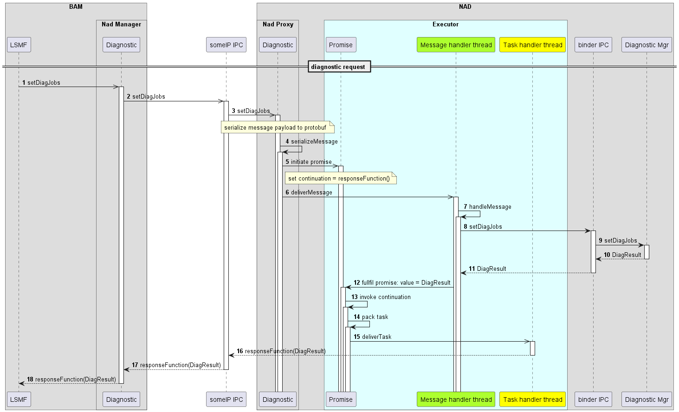
Apply new promise and executor

Slide 10
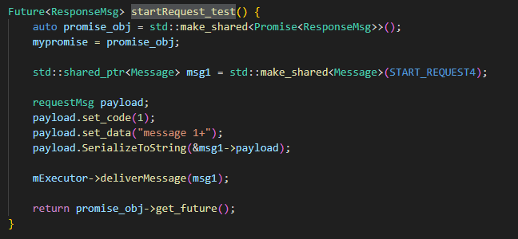
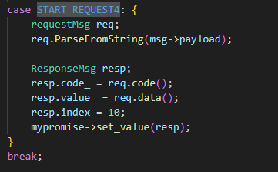
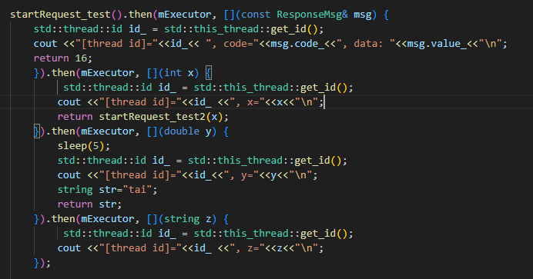
Demo

Slide 11
Appendix

Slide 12
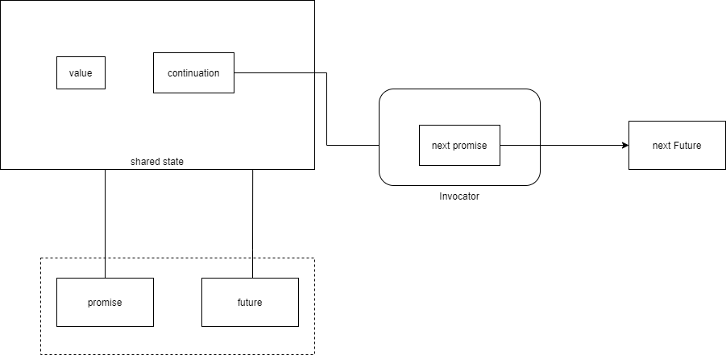
New Future/promise: BMW

Slide 13
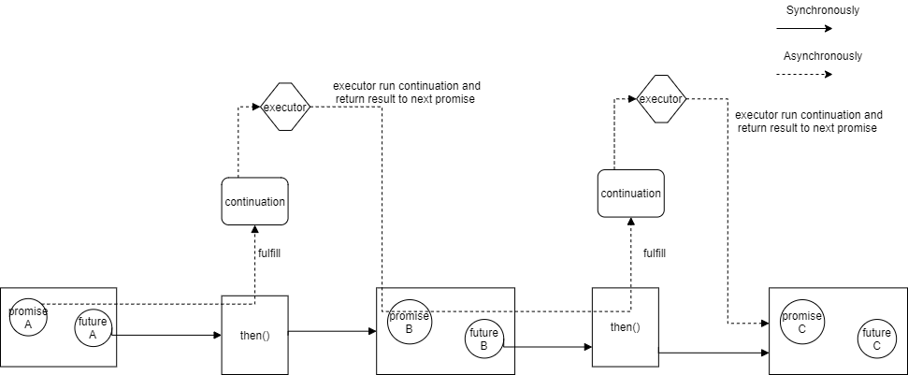
New future/promise
Notes:
https://wiki.commonjs.org/wiki/Promises/A

Slide 14
t1
task1()
File system
task Queue task1() task2() task3()
task2()
t2
task3()
Non-blocking tasks
t3
Nad Proxy
blocking tasks
Service 1
task1()
Event loop (single thread)
post(task1())
<<push task>>
Service 2
task2()
post(task2())
task Dispatcher
Service 3
task3()
post(task3())

Slide 15
Worker thread pool (dynamic allocator)
task Queue task1() task2() task3()
Nad Proxy
Service 1
task1()
Blocking task?
post(task1())
<<push task>>
File system
Service 2
task2()
post(task2())
task Dispatcher
Event loop (single thread)
Service 3
task3()
post(task3())

Slide 16
Concurrency model
Option 1:
Dynamic allocator (above)
Main dispatcher: while loop (always running)
Worker dispatcher: run until message queue is empty
Timer to trace a blocking call msg handling
If timeout, invoke new thread for new dispatcher (similar vsomeip)
Option 2:
Thread pool (fix pool size)
All worker threads compete messages from queue
All worker thread has same role
Option 3:
Leader-follower pattern
Also thread pool (only one leader waiting message from queue)
One leader wait for event, other follower sleep
When leader dispatch event, it promotes new leader, current leader handle event as processing thread
New leader wait for event…

